Slide 1
PID Balance Ball 106030009 葉蓁

Slide 2
Outline
Goal
Principle
Design Flow
Program Flow
Part list
Demonstration
Discuss

Slide 3
Goal
1

Slide 4
Goal
Given a constant setpoint, the machine should stabilize the ball at that position under interference.

Slide 5
Principle
2

Slide 6
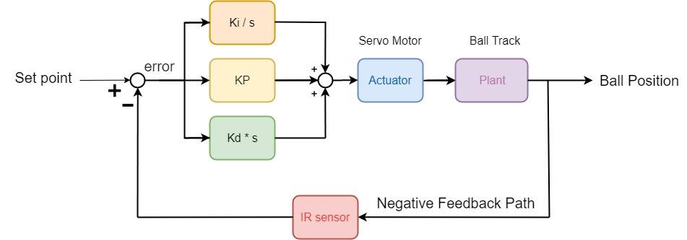
Principle
PID control

Slide 7
PID control
P control : To reach setpoint.
I control : To reduce steady state error.
D control : To stop the ball at setpoint.
(Reduce overshoot)

Slide 8
Design Flow
3

Slide 9
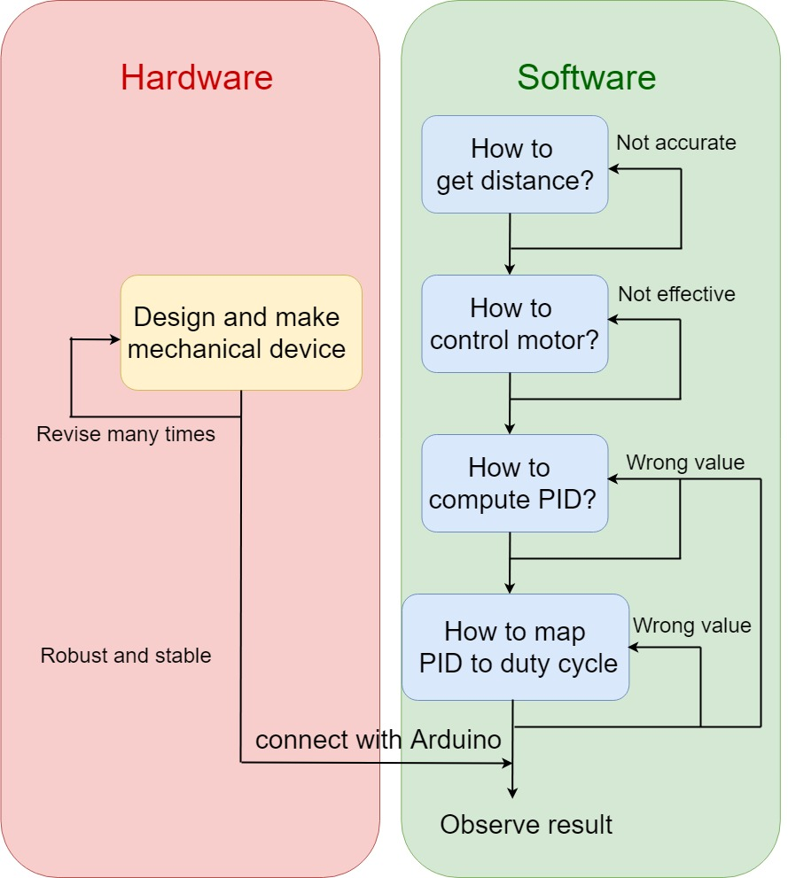
Design Flow
Notes:
流程圖

Slide 10
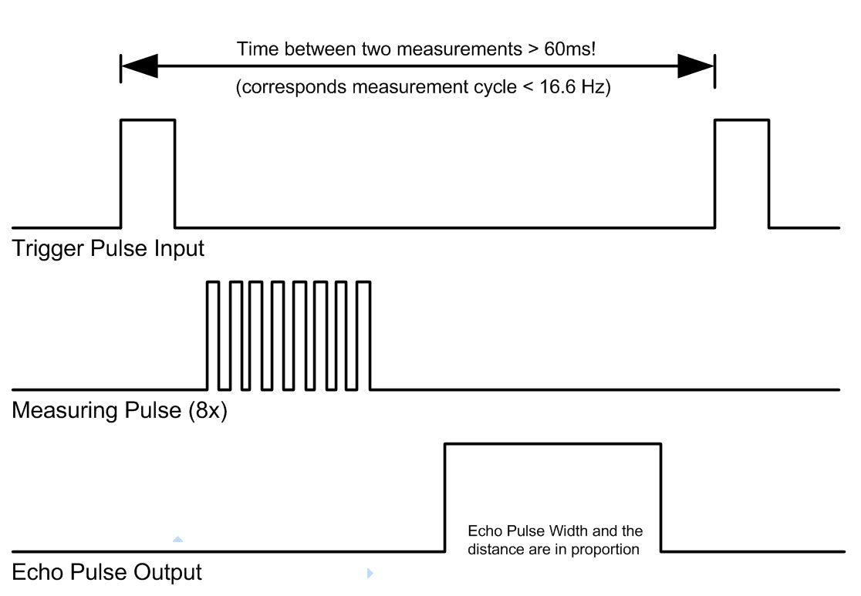
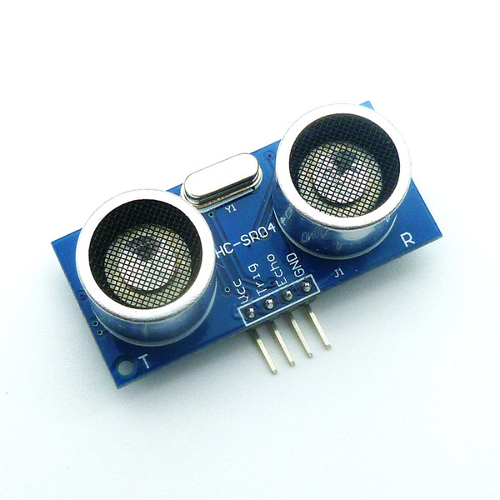
How to get distance?
Easy, but
Not accurate!

Slide 11
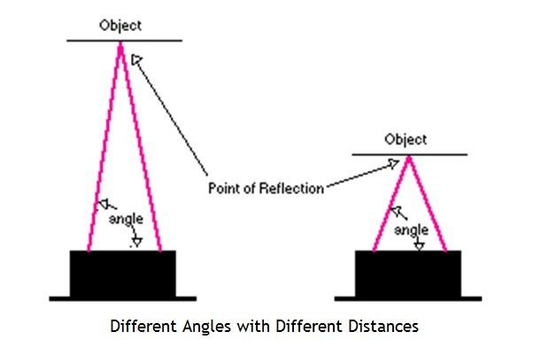
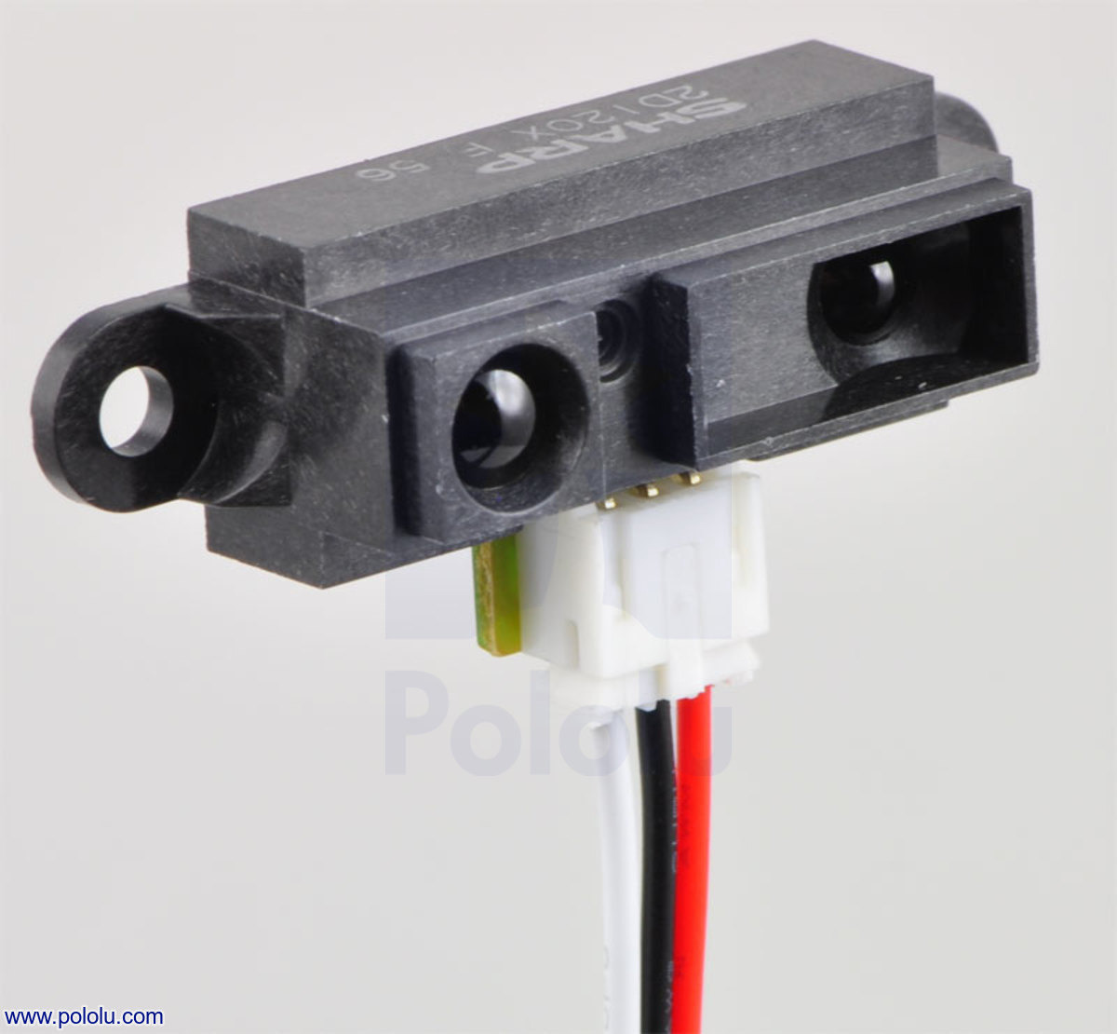
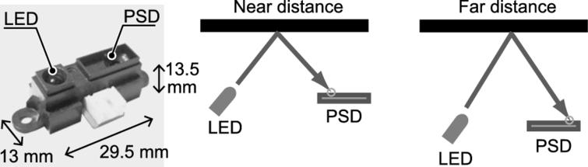
How to get distance?
More Accurate!

Slide 12
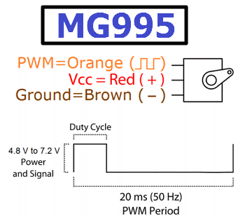
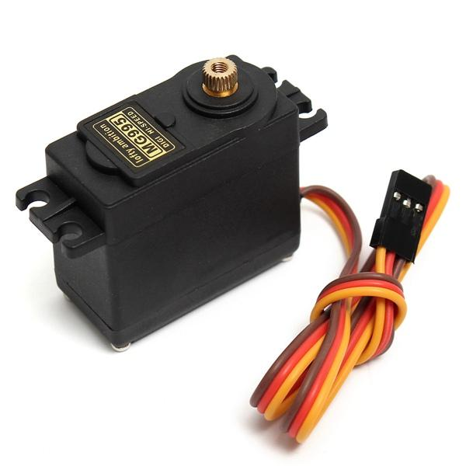
How to control servo motor?
Notes:
High torque13 kg-m/ 0-180degree

Slide 13
Program Flow
4

Slide 14
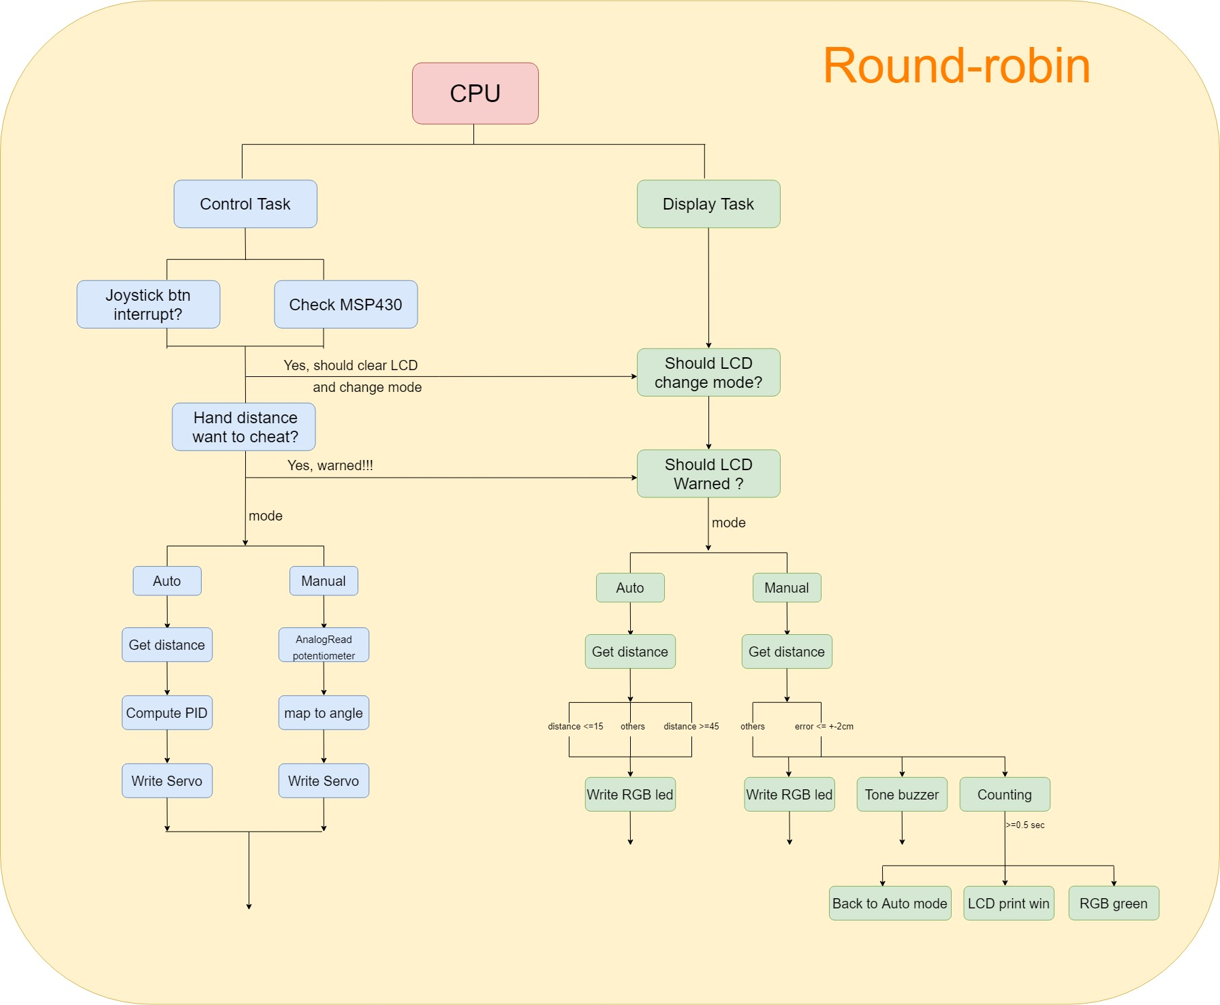
Program Flow
Notes:
Block diagram

Slide 15
Notes:
Block diagram

Slide 16
Notes:
Block diagram

Slide 17
Notes:
Block diagram

Slide 18
Part List
5

Slide 19
Electrical Device
Arduino UNO R3 *2 (one for power supply)
MSP430G2553
MG995 – Servo Motor / LCD
Infra Red distance sensor / Ultrasonic sensor
RGB / buzzer
Joysticks / 10K ohm potentiometer
Bread board
Jumpers

Slide 20
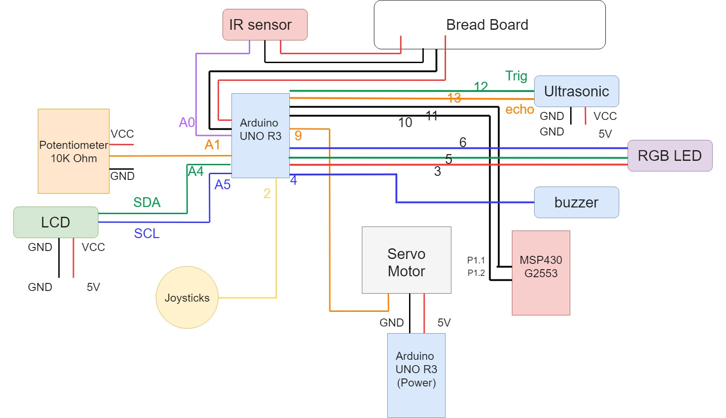
Schematic

Slide 21
Mechanical Materials
M4 nuts & screws
M3 nuts & screws
M4 screw 150mm
Motor Stand
Shaft Support
L-shaped Angle Steel

Slide 22
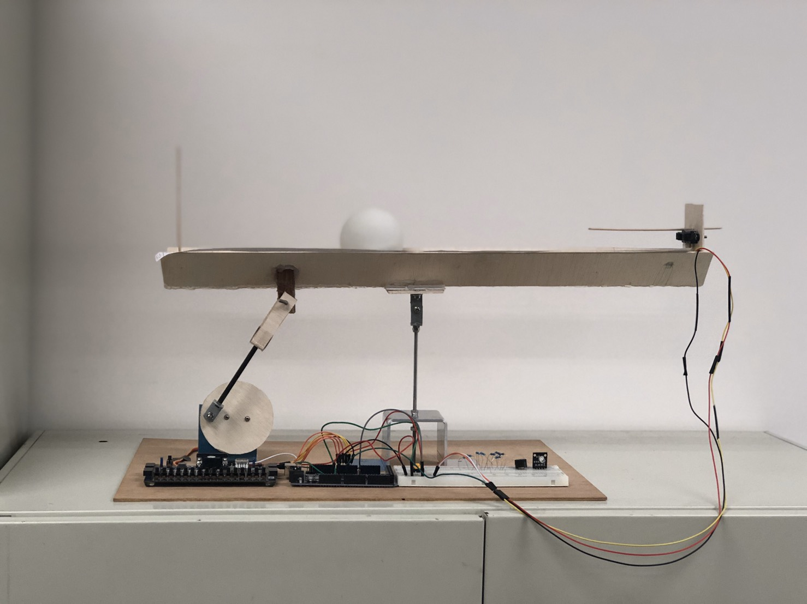
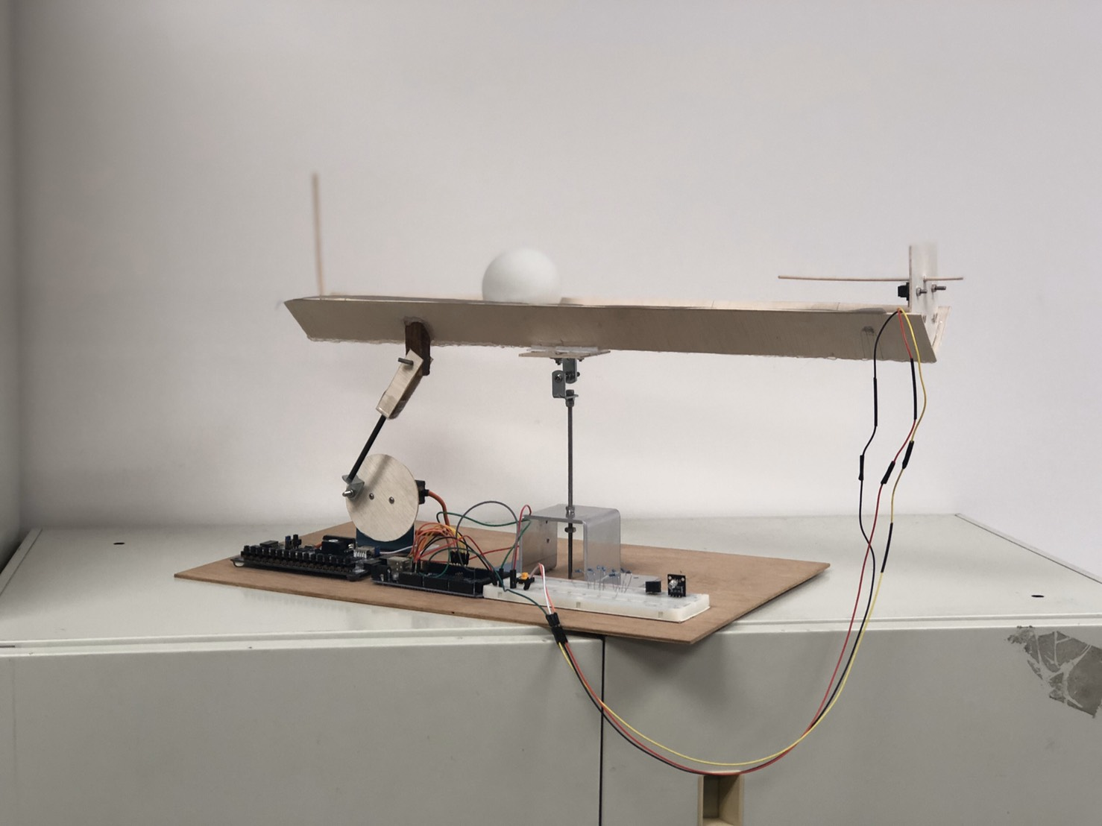
Final assembly

Slide 23
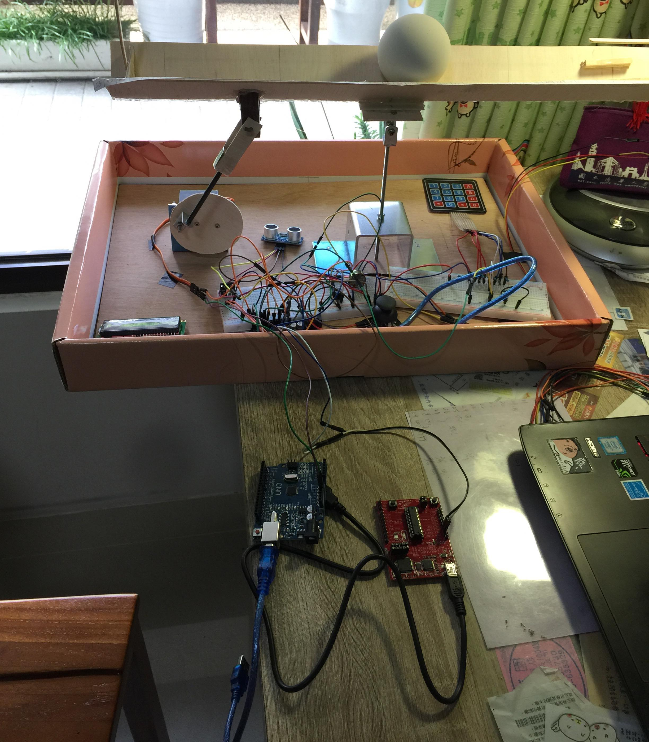
Aruduino UNO (Main program)
Aruduino UNO (Power supply)
MSP430G2553

Slide 24
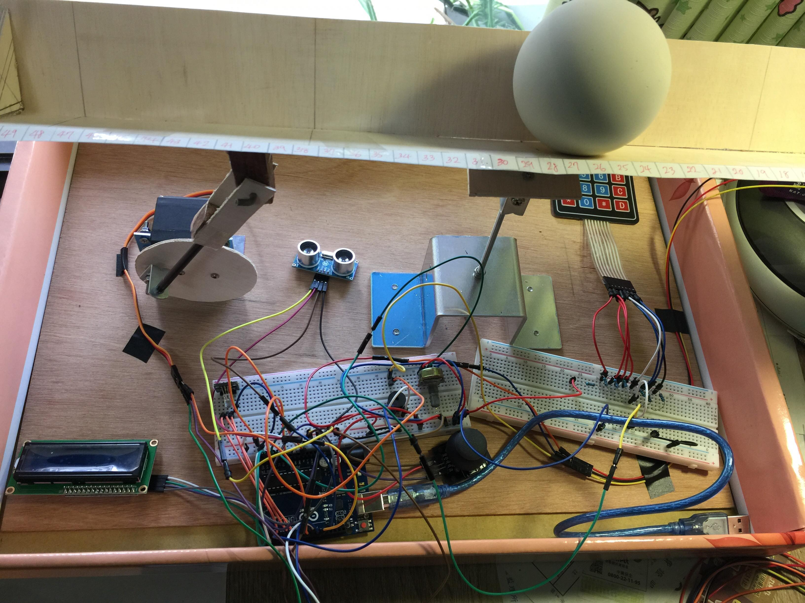
Infrared sensor
(not shown in this figure)
Keypad
MG995 servo motor
Potentiometer
Ultrasonic
buzzer
RGB led
Joystick
LCD

Slide 25
Component Functions
Infra Red distance sensor : Get ball distance
MG995 – Servo Motor : Actuator
LCD : Print details
RGB : Distance hint
Buzzer : Warning / Success
Ultrasonic sensor : Cheating detect
10K ohm potentiometer : Manual mode controller
MSP430G2553 btn & joystick : switch modes

Slide 26
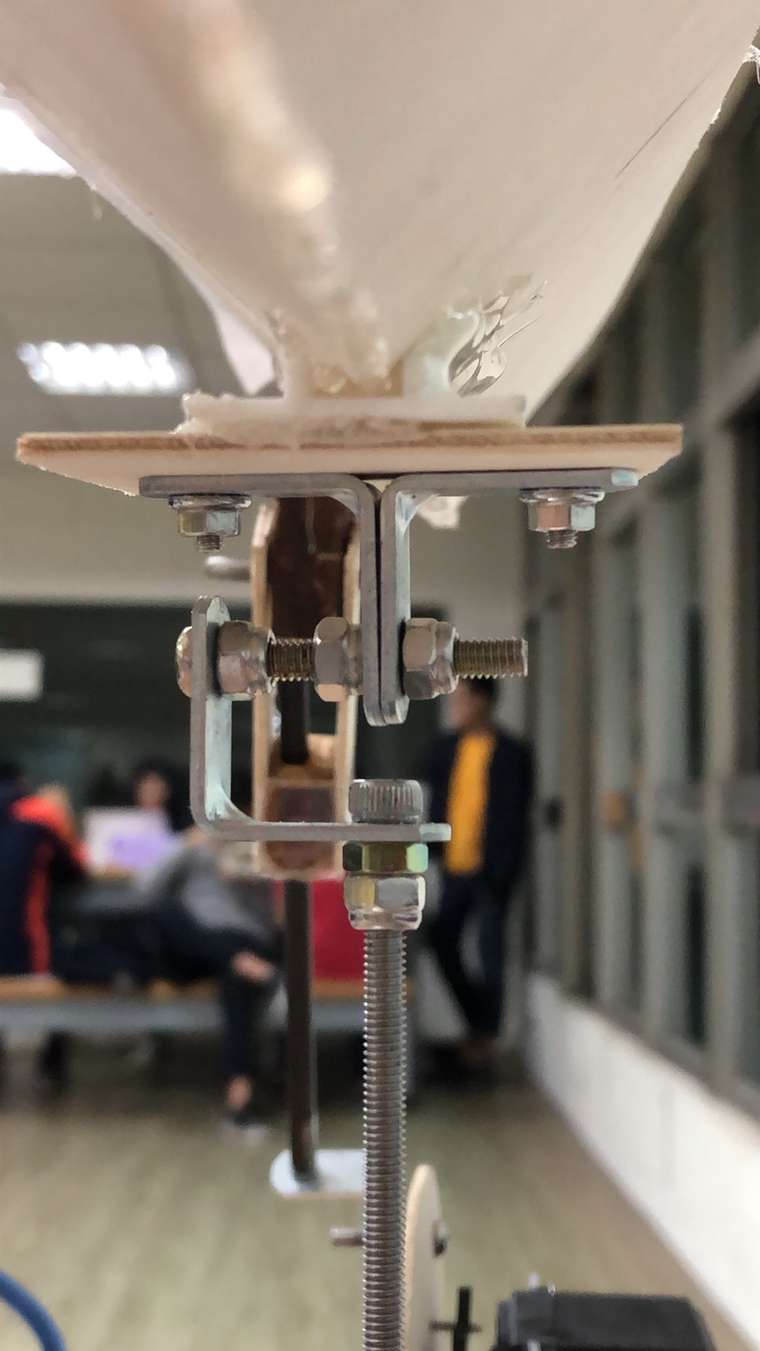
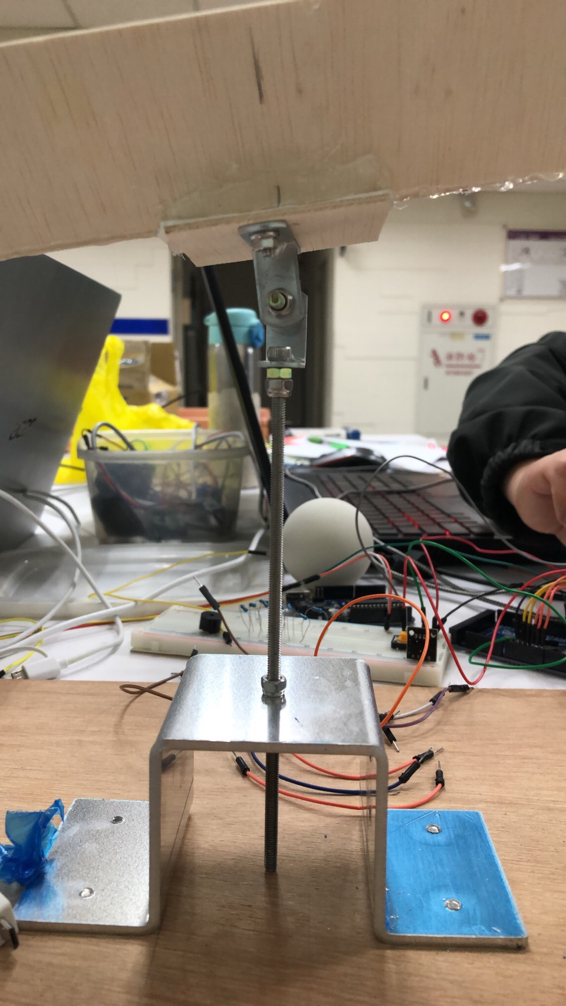
Balance Beam System

Slide 27
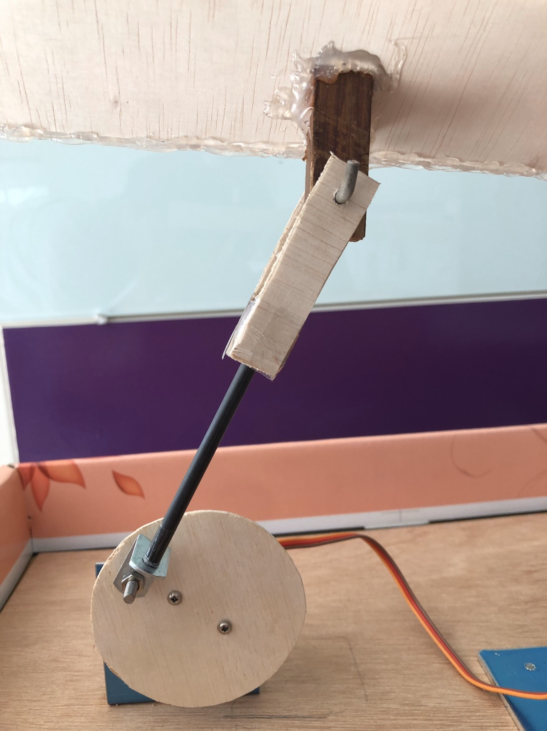
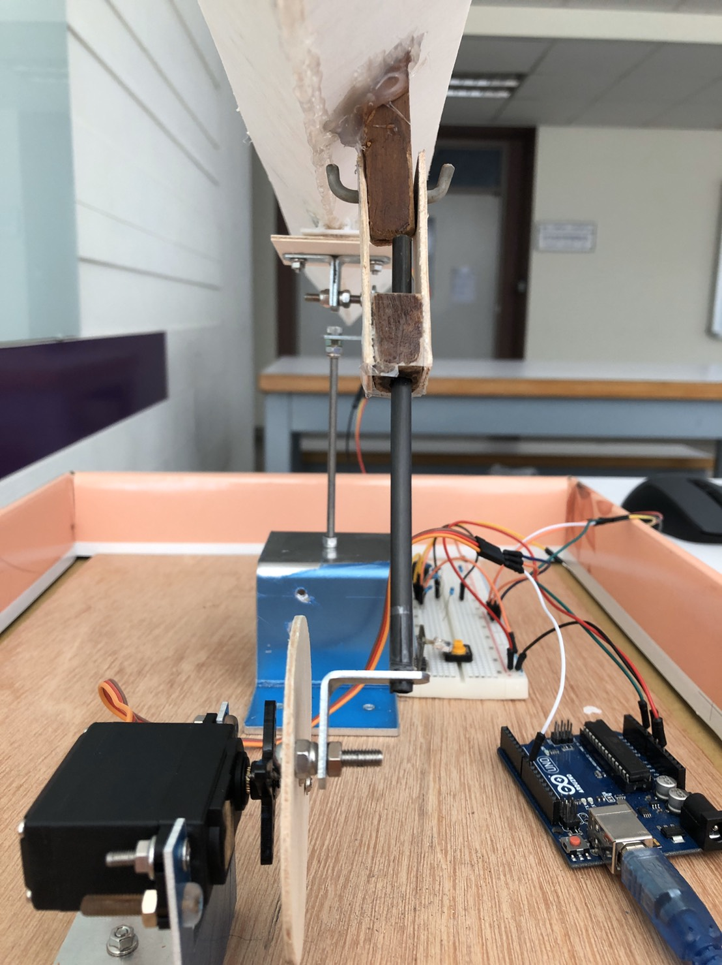
Multi-link System

Slide 28
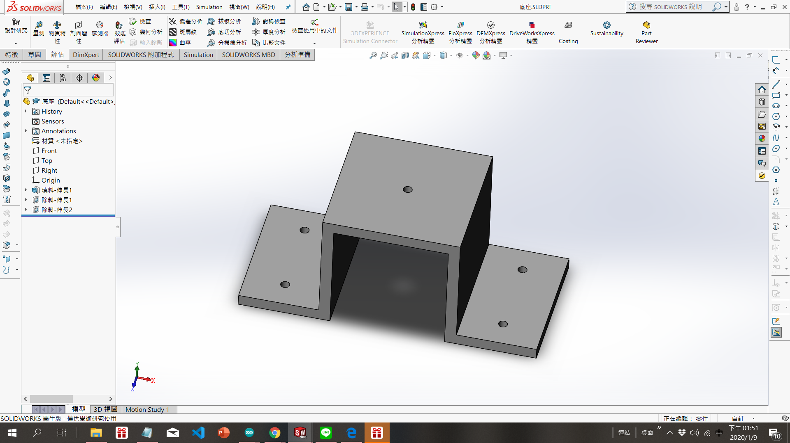
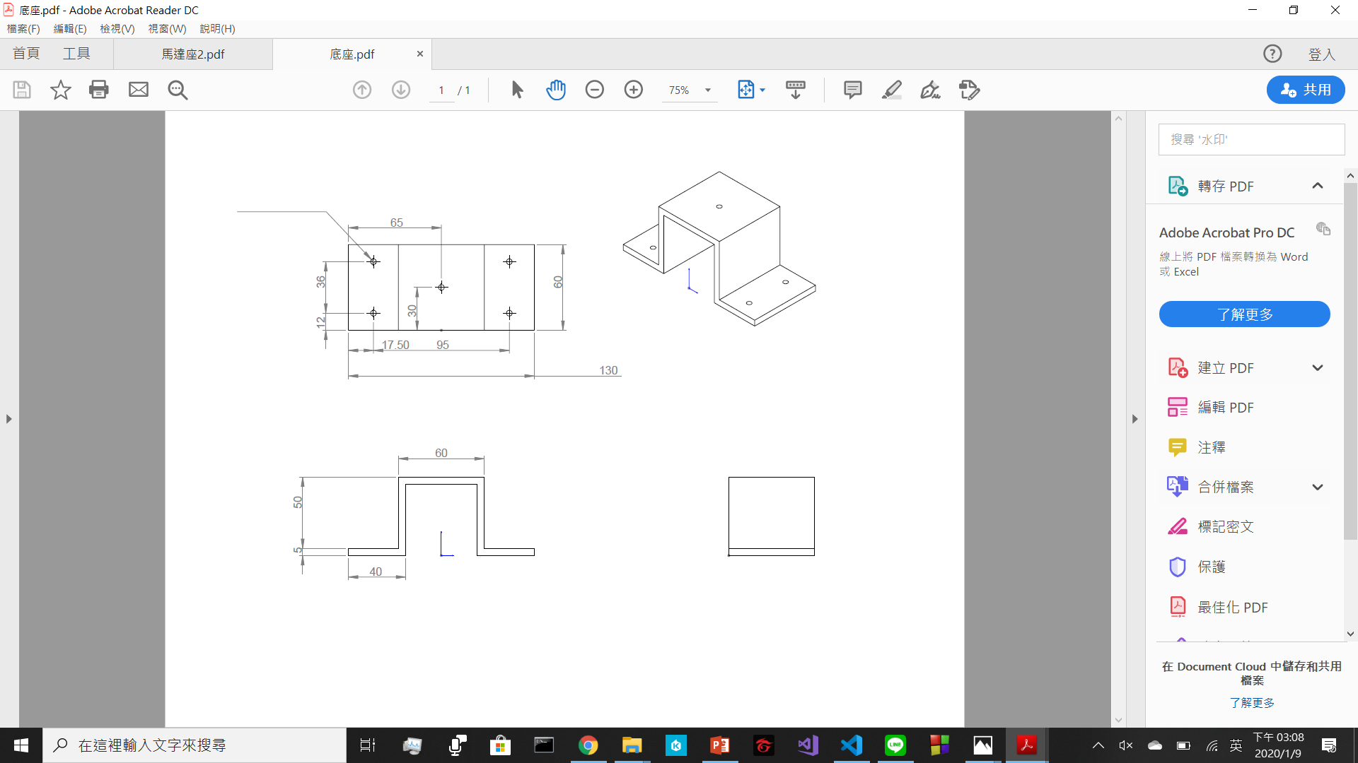
Engineering Drawing-Shaft Support

Slide 29
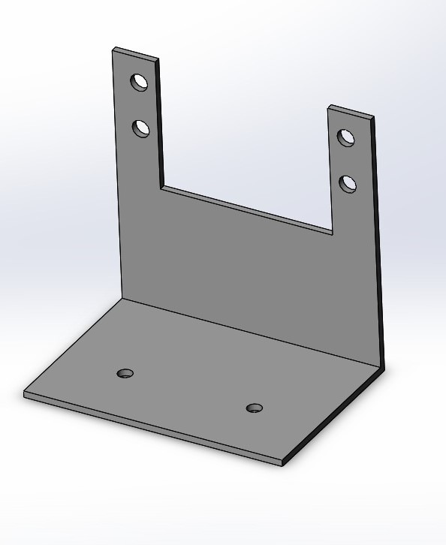
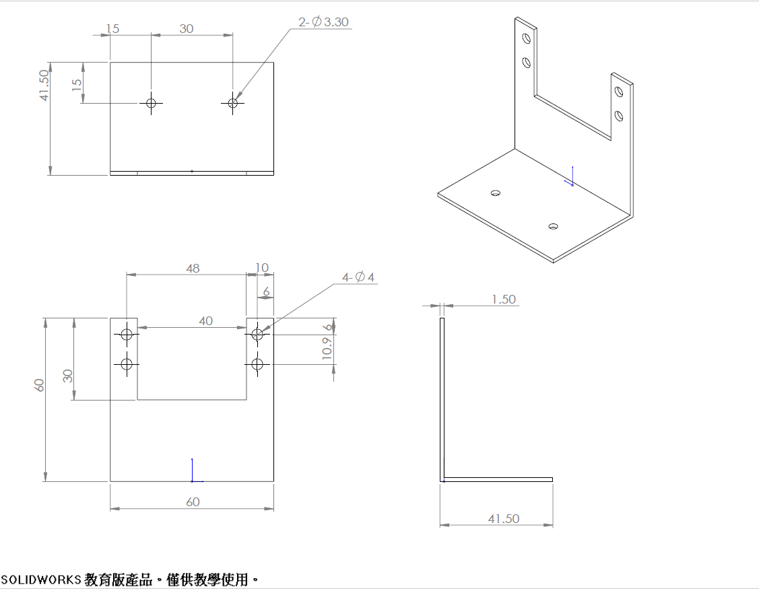
Engineering Drawing-Motor Housing

Slide 30
Demonstration
6

Slide 31
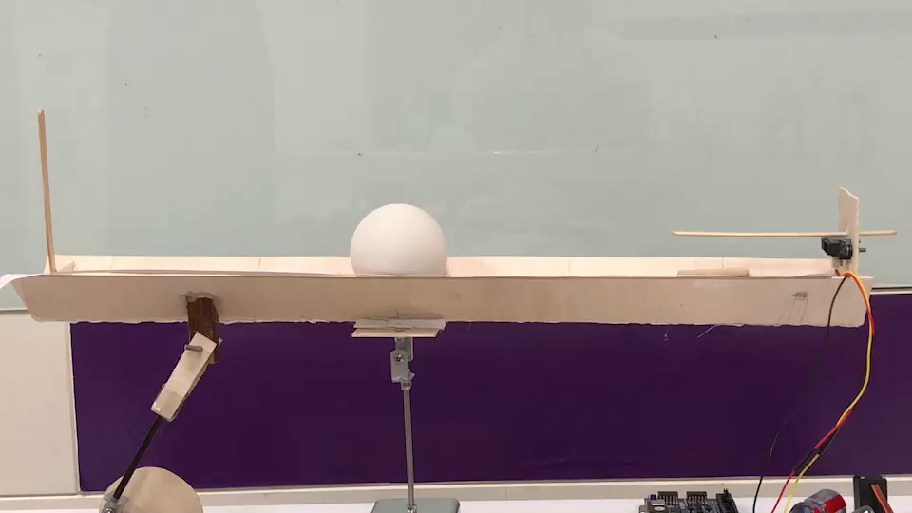
PID Control Video-1

Slide 32
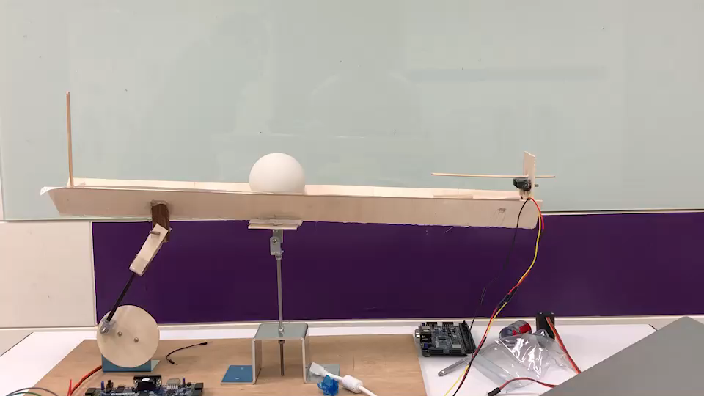
PID Control Video-2

Slide 33
Discuss
7

Slide 34
Discuss
Can we dynamically change set point?
-Keypad, memory issue.
Can we extend the dimension more, e.g. 2D balance ball plate. The mechanism, sensor used, and algorithm would be far more complex.
Can we use better control method?

Slide 35
THANKS!
Any questions?

